Slide 1

Meeting Etiquette
Please be on Mute all the time.
Turn off Video, So that we can save bandwidth.
There is separate Q&A Section in End Please use that, Add questions in Google Form.
Break at 12PM for 5 min.
Mute your microphone
To help keep background noise to a minimum, make sure you mute your microphone when you are not speaking.
Be mindful of background noise
Avoid multitasking
All links and Slides will be shared.

Slide 2

Agenda
SDET learning Path.
Why API Testing?
What is API Testing?
Mastering REST, SOAP Vs REST
HTTP Basics
POSTMAN OVerview
Collections
Environment Variables

Slide 3
Download Postman
https://www.postman.com/downloads/

Slide 4
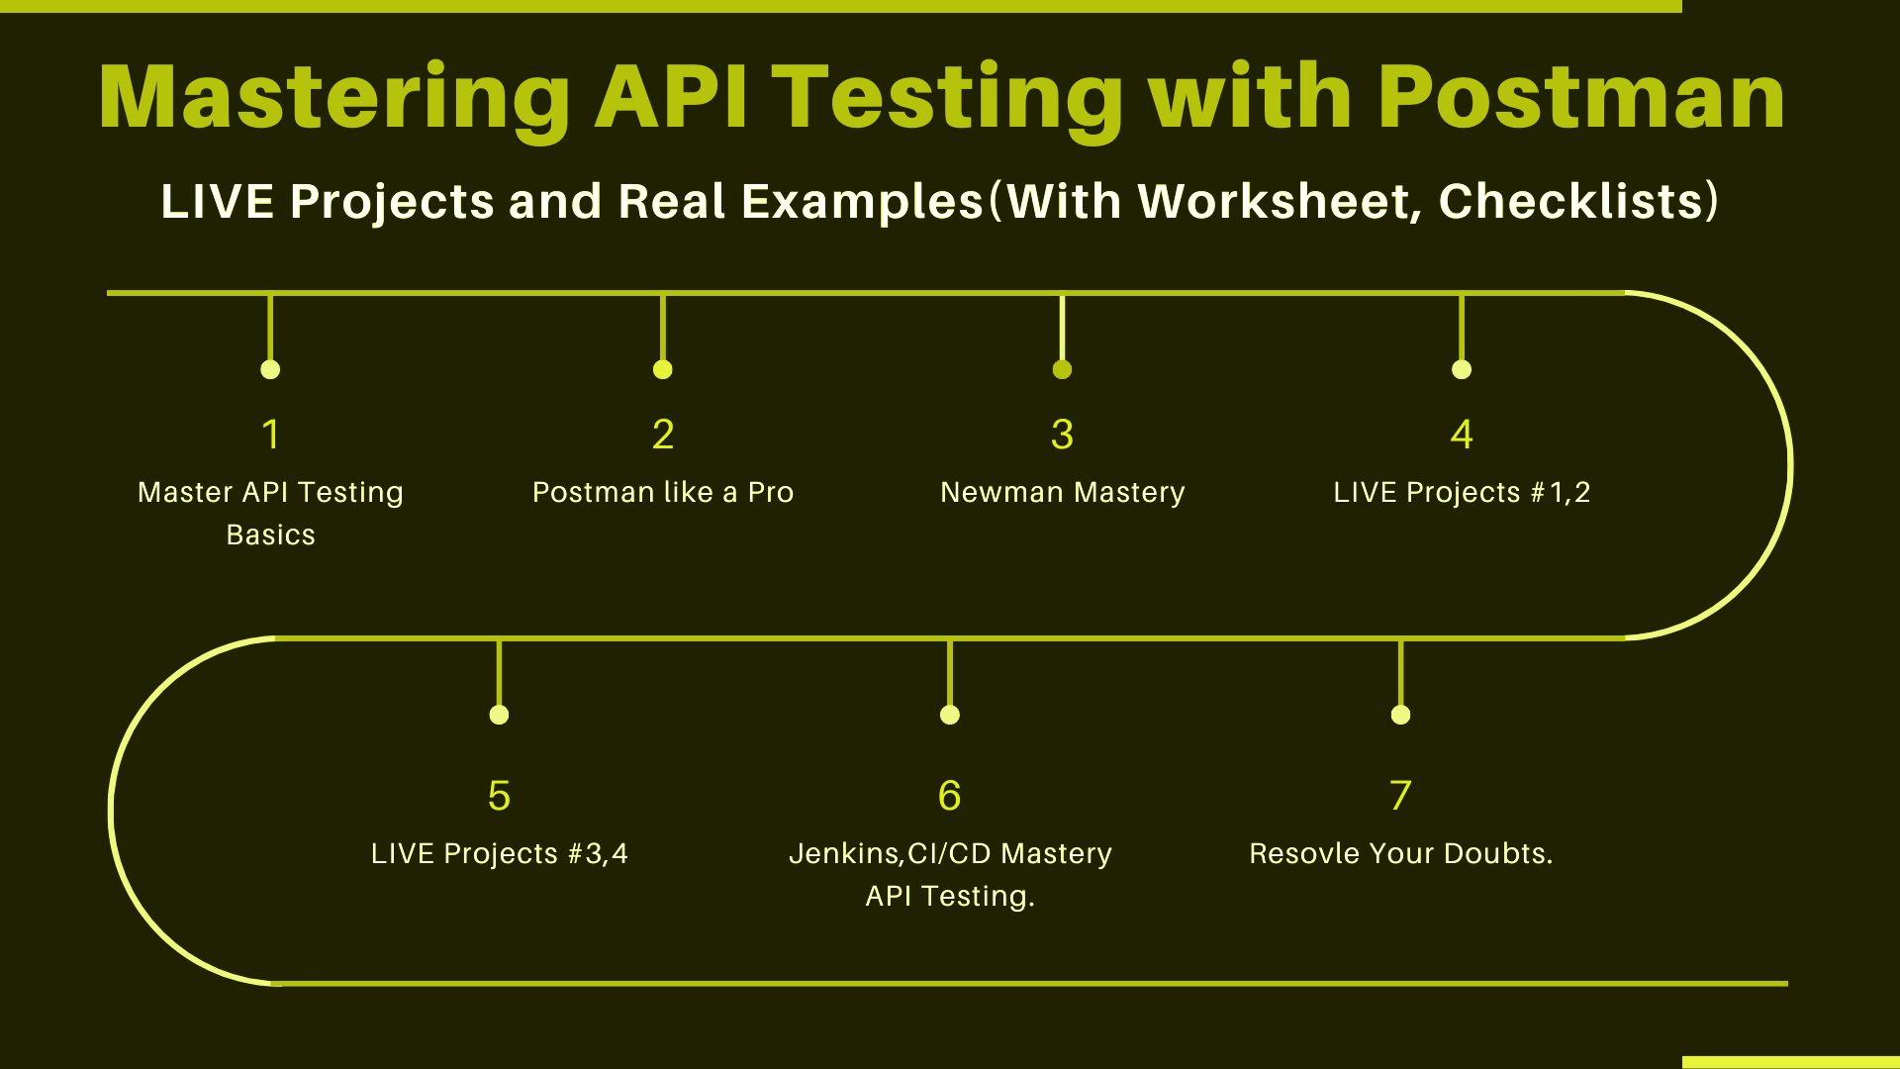

Slide 5

Why API Testing?
Millions of Web Apps and Mobile Applications use APIs.

Slide 6
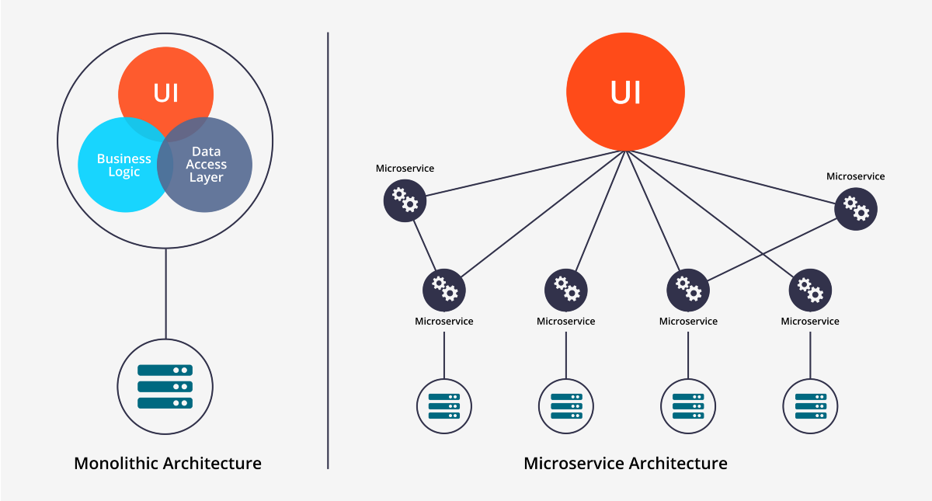
Why API Testing?
MicroServices Architecture.

Slide 7
Microservices
Architectural style that structures an application as a collection of services
Highly maintainable and testable
Loosely coupled
Independently deployable
Organized around business capabilities
Owned by a small team Read more - https://microservices.io/

Slide 8
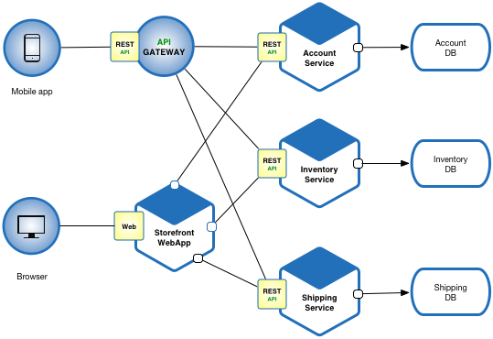
Microservices

Slide 9
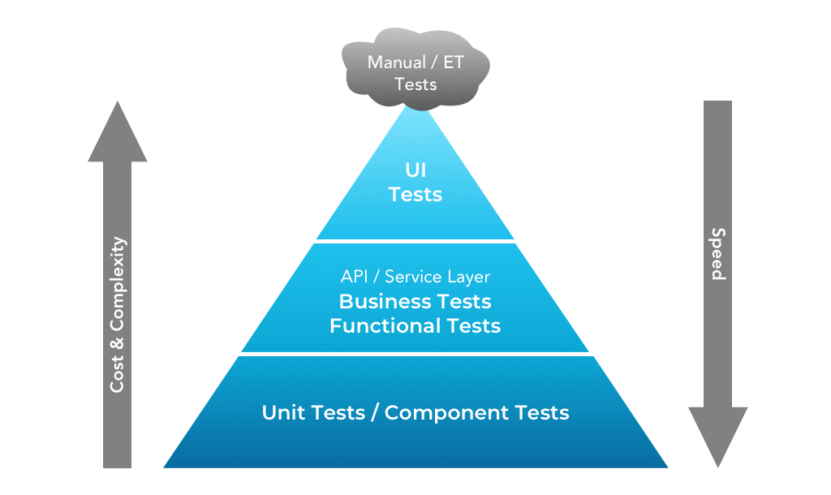
Why API Testing?
Why API Testing?
.UI Testing is costly.
API Testing is easy and can caught early Bugs.

Slide 10
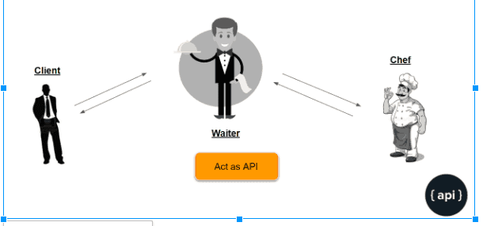
What is API ?
API stands for the Application Programming Interface,

Slide 11
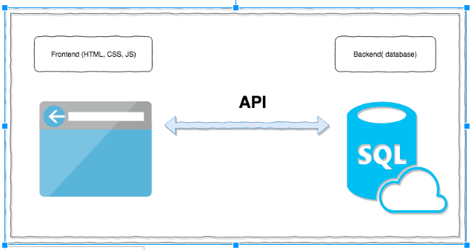
What is API ?
Basically a collection of functions and procedures which allows us to communicate two applications or libraries.

Slide 12
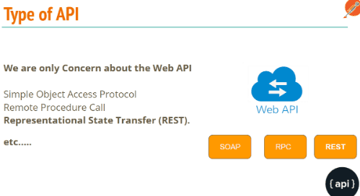
Type of APIs :
We are going to Learn REST API Testing.

Slide 13
What is REST API?
REST is an acronym for REpresentational State Transfer.
The REST architectural style describes six constraints.
These constraints, put on the architecture, were initially communicated by Roy Fielding in his doctoral dissertation and defines the basis of RESTful-style.

Slide 14
What is REST API?
In Simple Terms REST API is nothing but a Design Pattern for Web API

Slide 15
REST Constraints
Uniform Interface
Stateless
Cacheable
Client-Server
Layered System
Code on Demand
https://scrolltest.com/rest/explained

Slide 16
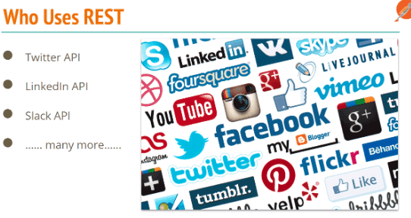
REST Used by ….
Most of WebApps, Mobiles are relying on REST API

Slide 17
What To Test in APIs?

Slide 18
What To Test in APIs?
Verify the Parses JSON or XML response.
HTTP Status Code.
Verify Headers response with Negative or invalid headers.
Max/ Min Key values.
Have a test case to do XML, JSON Schema validation.
Verify that how the APIs error codes handled.
Missing Keys
Empty Updates or POST call handling.
Chaining request verification.
End to End Crud.
Database integrity test
File upload.

Slide 19
What is Test in APIs?
Test nulls and empty strings, these have a habitat of causing issues ;).
Test with Unicode characters, ensure they are correctly saved to the database.
Test mandatory and optional parameters, in particular test with just mandatory values.
Ensure correct status codes are returned, you will find false positives e.g a 500 being returned as a 200.
Functionality Bugs: the test looks for missing functionality bugs
Reliability Bugs: API testing helps identify bugs pertaining to integration across different systems
Performance Bugs: The tests help determine how much traffic the system can handle before being overloaded, and how to expand infrastructure to meet rising demand at the core, but also are very effective at pinpointing weak points in the API
Security Bugs

Slide 20
What is Test in APIs?
Boundary Value Analysis (BVA)
Equivalence Class Partitioning
Decision Table based testing
Error Guessing
State Transition

Slide 21
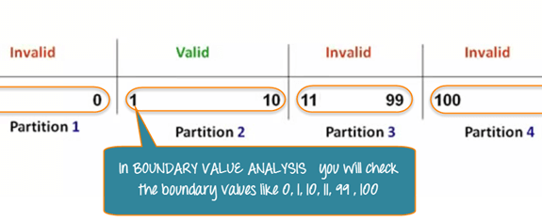
Boundary Value Analysis.

Slide 22
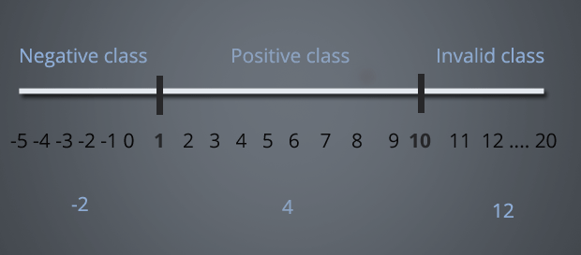
Equivalence Class Partitioning

Slide 23
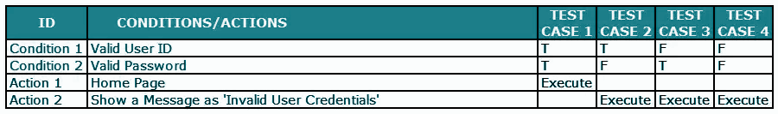
Decision Table based testing

Slide 24
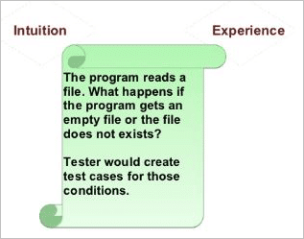
Error Guessing

Slide 25
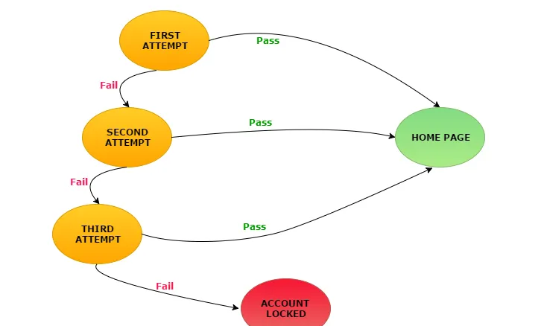
State Transition
Take an example of login page of an application which locks the user name after three wrong attempts of password.

Slide 26
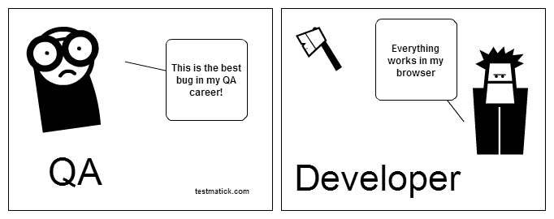
Reason

Slide 27
Type of Testing in API Testing?

Slide 28
Functional Testing.
Integration Testing
Regression Testing
Security Testing
Load Testing
Penetration Testing
Fuzz testing - discover coding errors

Slide 29
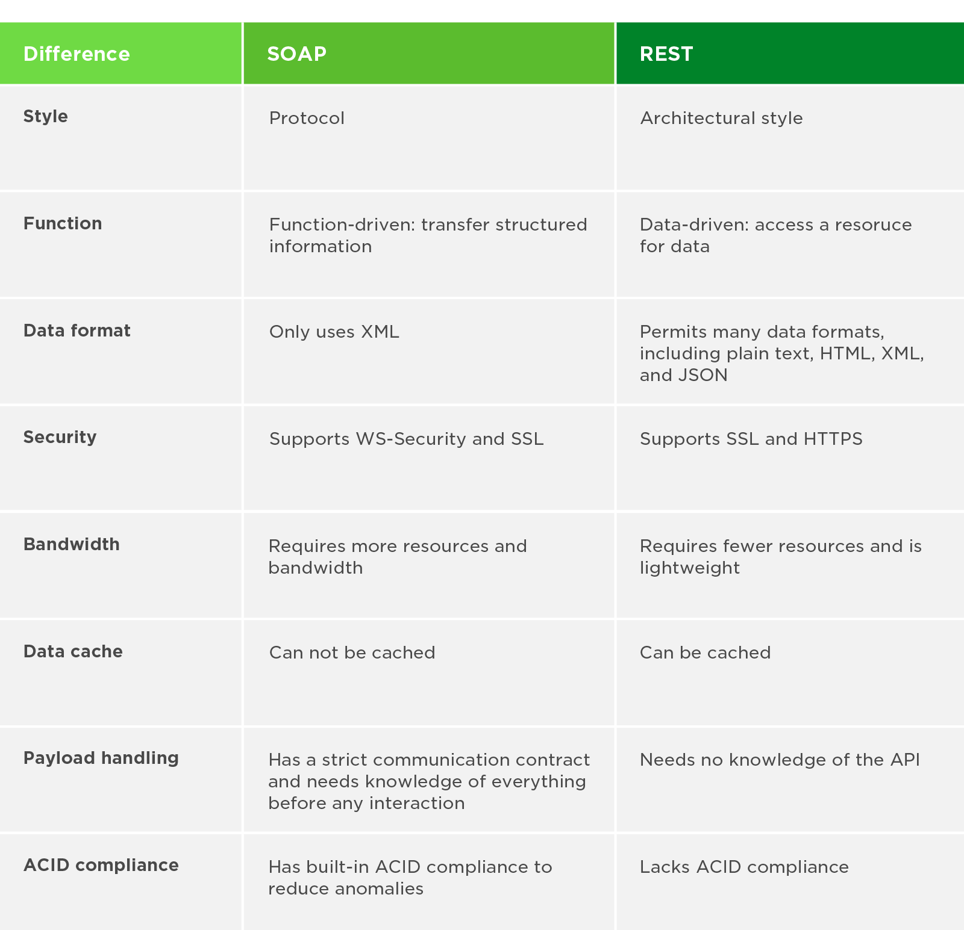

Slide 30
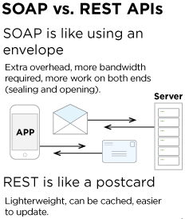

Slide 31
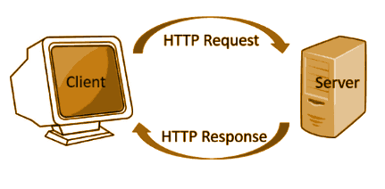
HTTP Fundamentals

Slide 32
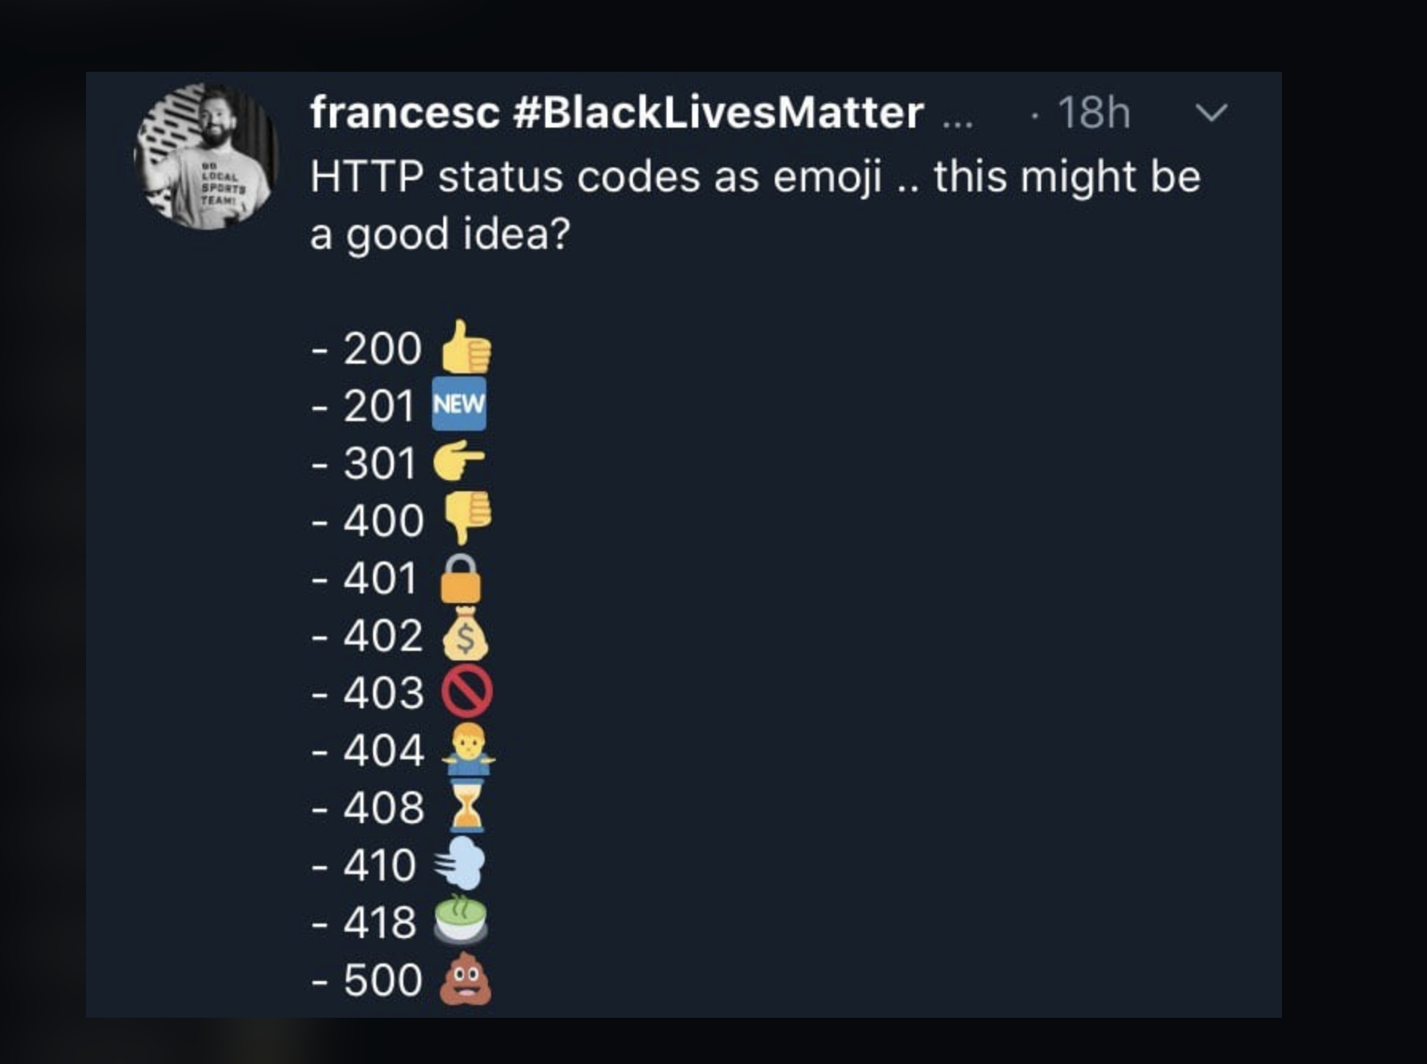
HTTP Methods

Slide 33
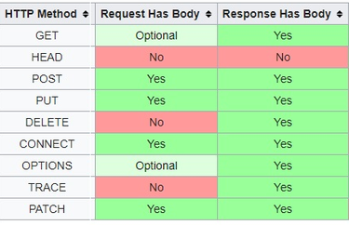
HTTP Methods

Slide 34
POSTMAN Basics

Slide 35
POSTMAN Basics
OverView
Import External Request.
History
WorkSpace in Postman
Postman Tabs - Param, Auth, Headers, Body, Pre-req, Post Req(Test), Settings
Postman Console.

Slide 36
POSTMAN Basics
Assignment

Slide 37
POSTMAN Basics
Exporting Code.
Managing Cookies in Postman.
Share Collection
Monitor Collection
Publish Docs
Collection Runner
Data Driven Testing.

Slide 38
Authentication
Basic Auth - Base64 (username and password)
Digest authentication - User, Pass with Encryption
Bearer Tokens - They are predominant type of access token used with OAuth 2.0. Opaque string, not intended to have any meaning to clients using it.
JWT - Structured tokens

Slide 39
Postman Objects
pm.info.requestName:String
pm.sendRequest
pm.variables
pm.environment
pm.collectionVariables
pm.globals
pm.request
pm.response
pm.iterationData
pm.cookies
pm.cookies.jar
pm.test
pm.expect
pm.response.to.be.*

Slide 40
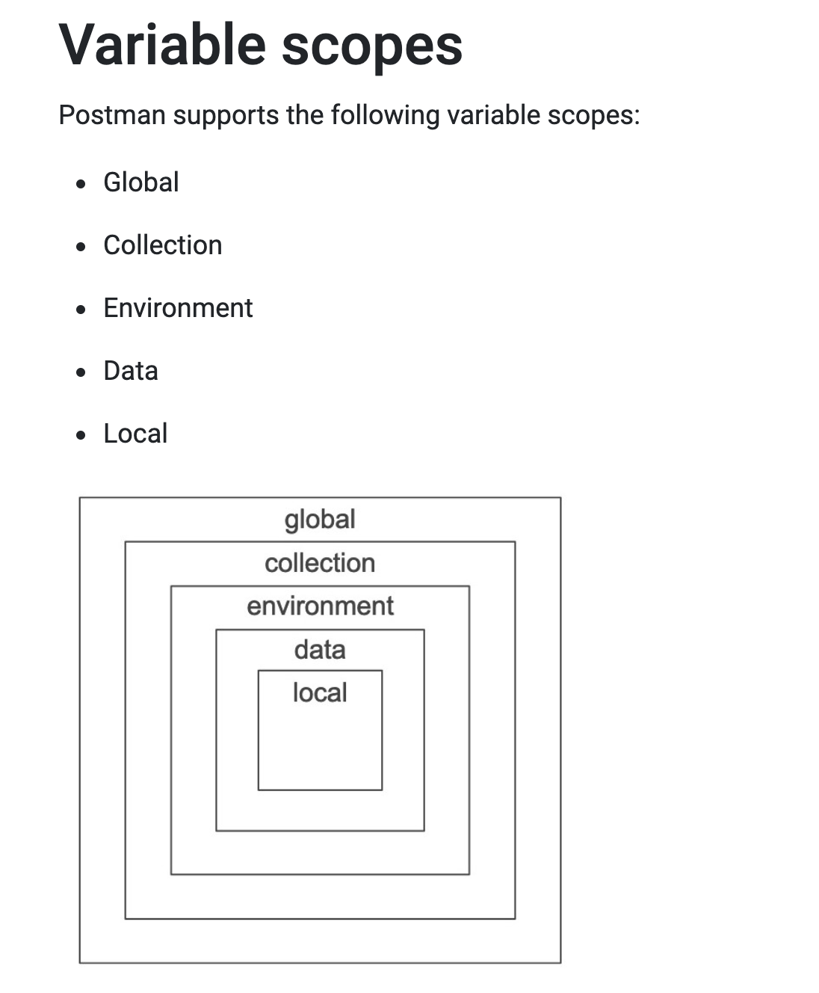
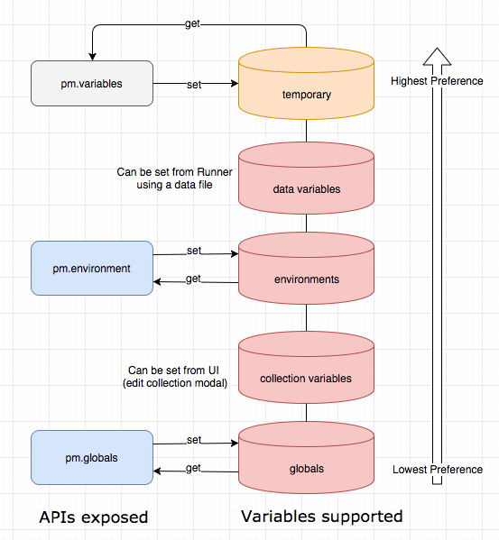
POSTMAN Variables

Slide 41
POSTMAN Variables
pm.globals.set("variable_key", "variable_value");
pm.environment.set("variable_key", "variable_value");
pm.environment.unset("variable_key");
pm.collectionVariables.set("variable_key", "variable_value");
pm.variables.set("variable_key", "variable_value");
pm.iterationData.get("variable_name").
Access
{{username}}
console.log(pm.variables.get("variable_key"));
Dynamic variables
{{$guid}} : A v4 style guid
{{$timestamp}}: The current timestamp (Unix timestamp in seconds)
{{$randomInt}}: A random integer between 0 and 1000

Slide 42
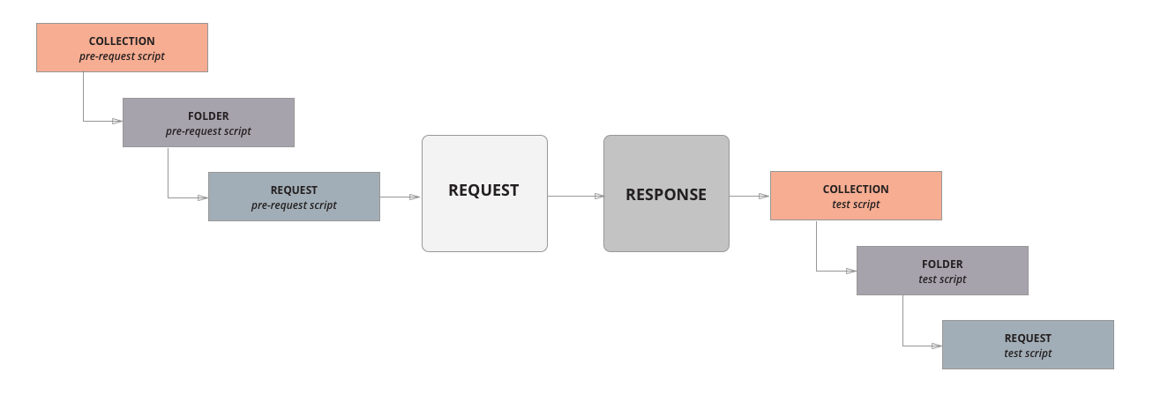
Scripts in Postman

Slide 43
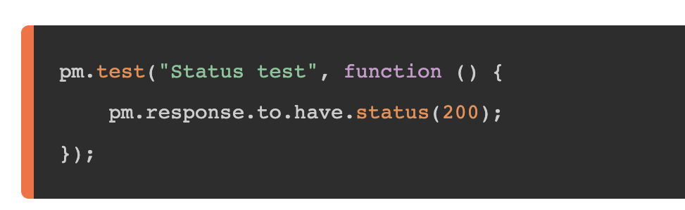
POSTMAN Test

Slide 44
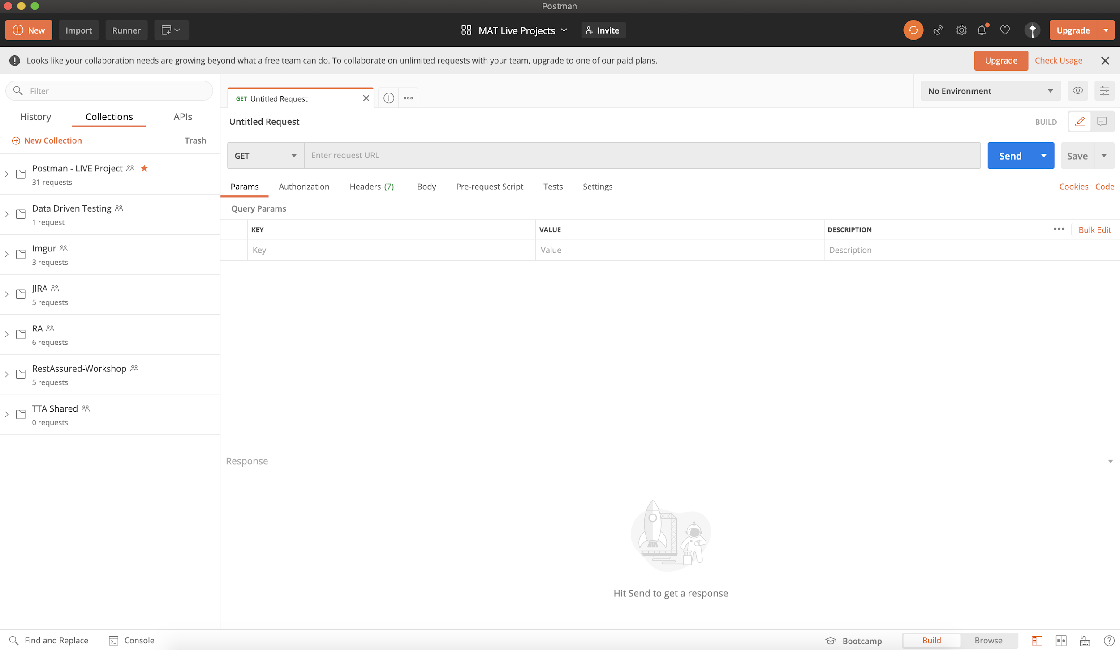

Slide 45
Break for 15 min

Slide 46
Download WorkBook https://apitesting.co/postman-1

Slide 47
Now….important stuff..

Slide 48
LIVE CRUD in Postman #1

Slide 49
NewMan Basics

Slide 50
NewMan Commands
npm install -g newman
newman run -h
Run collection - newman run mycollection.json
Run Collection with Env - newman run https://www.postman.com/collections/cb208e7e64056f5294e5 -e dev_environment.json
-e - environment, -g global , -d for iteration, --f folder, -n 3 iteration count.
--delay-request [number] , --timeout-request
--bail - Stop if any test fails
-k for insecure

Slide 51
NewMan Reports
Newman-reporter-htmlextra - newman run collection.json -r htmlextra - https://github.com/DannyDainton/newman-reporter-htmlextra

Slide 52
JSON Schema
Validate JSON documents.

Slide 53
JSON Schema
{}
{ "type": "string" }
{ "$schema": "http://json-schema.org/schema#" }
"minLength": 2,
"maxLength": 3
"pattern": "^(\\([0-9]{3}\\))?[0-9]{3}-[0-9]{4}$"
Properties
Required
items

Slide 54
JSON Schema
https://www.jsonschemavalidator.net/
https://www.jsonschemavalidator.net/s/hG6wNqk4
https://ajv.js.org/keywords.html

Slide 55
CI/CD
Install jenkins
Install plugins-nodejs, html publisher
Install newman packages in tool config- newman newman-reporter-html newman-reporter-htmlextra
Configure nodejs in jenkins job
Fix css display issue by running this in script console -System.setProperty("hudson.model.DirectoryBrowserSupport.CSP", "default-src 'self' 'unsafe-inline' 'unsafe-eval'; img-src 'self' 'unsafe-inline' data:;")
Fix unicode issue by adding --disable-unicode flag

Slide 56
CI/CD
Configure email from global config, make sure email is not having 2 step verification and secure apps settings on gmail account is turned off -https://myaccount.google.com/u/2/lesssecureapps
Run collection- newman run https://www.getpostman.com/collections/9d8ab00a0ed603dc6a1c --global-var baseurl="https://api-staging-builder.engineer.ai/" --disable-unicode --reporters cli,junit,html,htmlextra --reporter-html-export newman/htmlreport.html --reporter-htmlextra-export newman/graphicalreport.html --reporter-htmlextra-title "API Automation Suite Report"

Slide 57
Docker Demo
Install docker- sudo apt install docker.io
Verify docker is installed- docker -v
Pull newman image -$ sudo docker pull postman/newman;
Run Collection-
docker run -t postman/newman run "https://www.postman.com/collections/8a0c9bc08f062d12dcda"

Slide 58

QnA
Go to link -
https://forms.gle/48eEPDsfxBNtDHRs5

Slide 59
Feedback
Go to Facebook -
https://www.facebook.com/groups/thetestingacademy/

